Slide 1

Notes:
This is blurry

Slide 2
Needfinding

Slide 3
Introduction
Team Members: Hannes Boehning, Eli Wopat, Lee Alpert, Mia Paulsen
Potentiation Problem Domain:
Communication
Resources
Language Acquisition

Slide 4
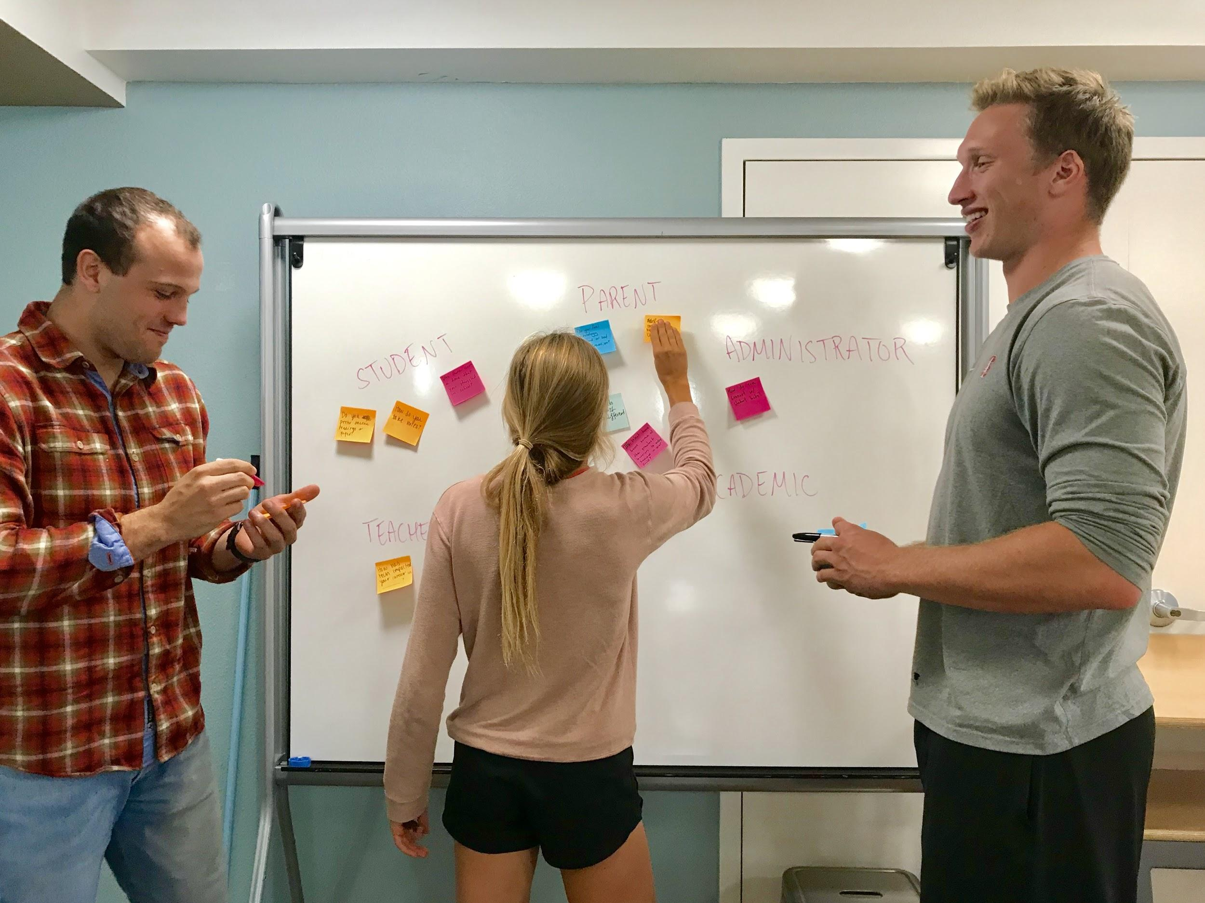
Brainstorming
Who are we trying to interview?
What questions are we going to ask?
What are some extreme users in our domain?
How are we going to find interviewees?

Slide 5
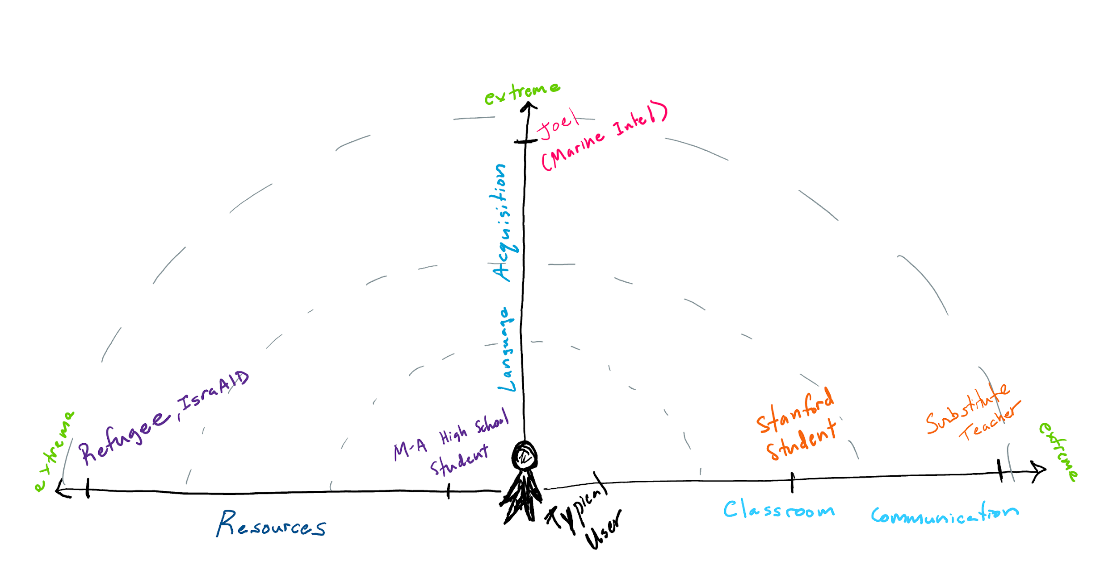
Extreme-O-Meter

Slide 6
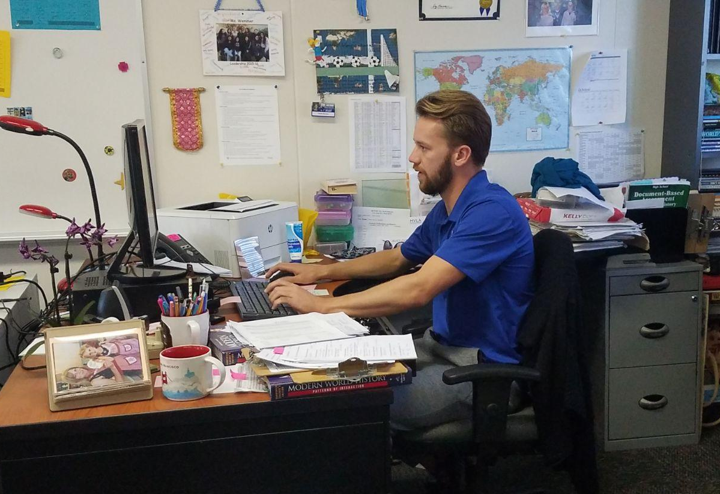
Interviewee #1, Keegan
Substitute teacher for Sequoia Union High School District
Substitute teachers see classrooms of many different subjects and ages
Knew of him through a summer job
Interviewed at the GSB

Slide 7

Interview Results
“There should be less technology in the classroom”
Notes:
- Seems to think that there is a disconnect between technology’s intentions and what actually happens in the classroom
- Technology gives children as many advantages as it does disadvantages
- Administration tries to implement district-wide technology, and the students end up teaching the teachers how to use technology
- There is no universally implemented educational technology system, and he sees different teachers and subjects rely heavily on completely different systems (ex: Canvas, Google Classroom, Edmodo, etc)

Slide 8
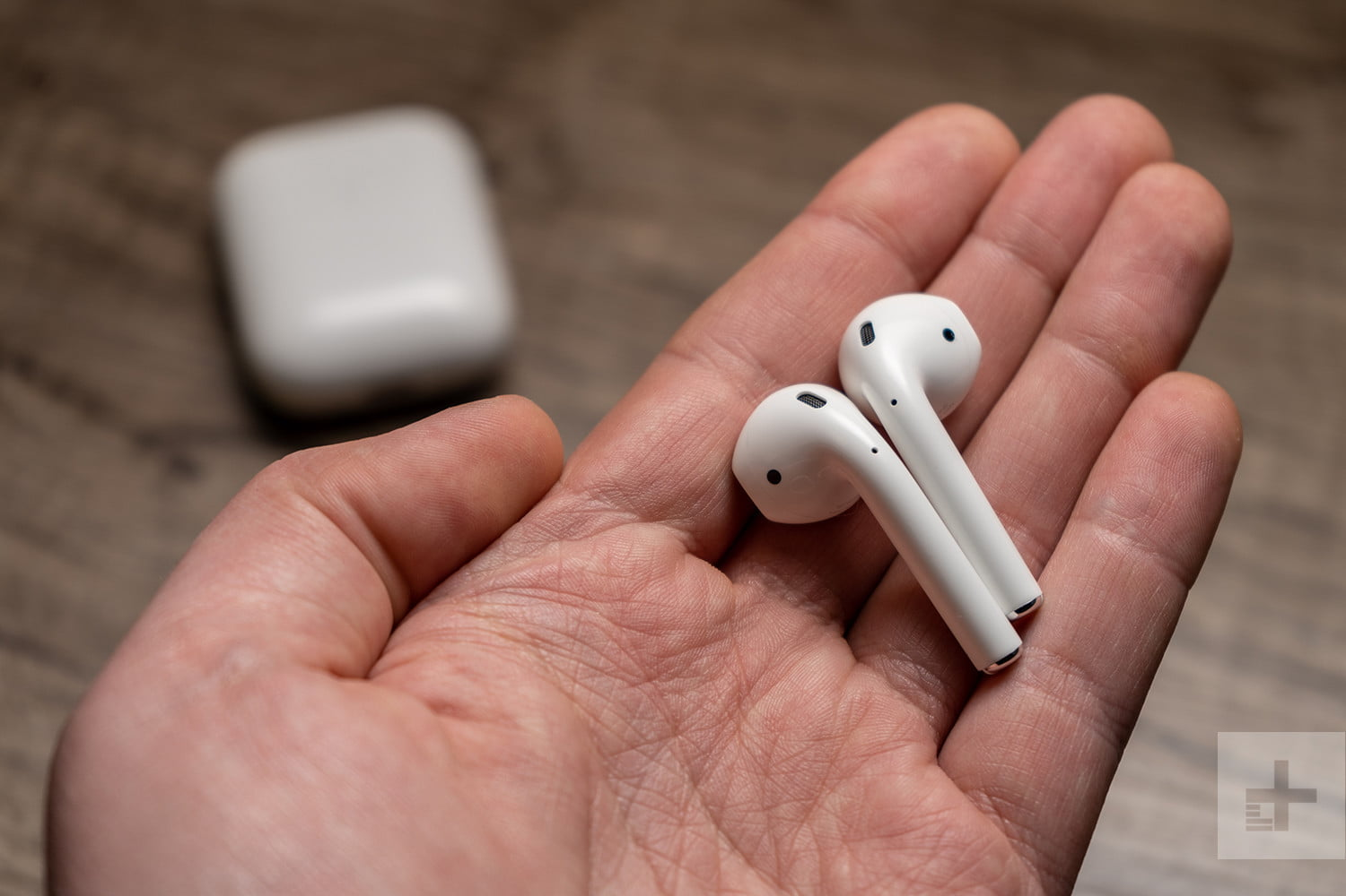
One of the biggest problems: wireless headphones
Notes:
- Wireless headphones anecdote: He has to call people’s names like 5 times because they will have an airpod in their ear but cover it with their hair or hood. You never know if they are listening to you or completely tuned out

Slide 9
“When you give a student a chromebook to do their readings or access an online textbook, they can just as easily open a tab to YouTube. We should instead give them a kindle that has all of their books on it but no access to the internet”
Notes:
The Kindle paper-white would replace textbooks with a higher degree of functionality without the added distraction of internet browsing. Additionally, teachers would spend less time monitoring tech usage in class and focus more on the curriculum. The entire library could be available for the students to do research and all text is searchable, highlightable, and translatable.

Slide 10
Interview Analysis
SAY “Specific technology” “Distractions” “Misunderstandings” | DO Would frequently sigh, pause, or laugh while explaining his frustrations
THINK He could be disappointed in the school system, and struggle with seeing such widespread problems in the education system | FEEL He might feel powerless as a substitute teacher, like he can’t affect positive change because he is only in each class for a small amount of time
Notes:
He sees more of the school district and classes than most people involved, but has little power to do anything

Slide 11
Conclusions & Questions
Make tech specific for education from the start, rather than trying to make it work with education after the fact.
Notes:
Students would be better served in the classroom using more specific technology to replace traditional methods of teaching, rather than general purpose high-tech gear

Slide 12

Interviewee #2, Sarith
Senior Director of Operations IsraAID USA
IsraAID is an NGO focused on global disaster risk reduction and response.
Notes:
Teaching empathy
Interviewed at local office
Lee had previous connection to the organization

Slide 13
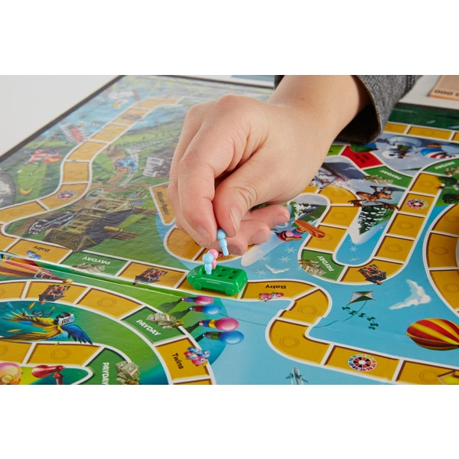
Interview Results
Two main involvements with education:
Disaster Risk Reduction
2. Awareness

Slide 14
“We’ve worked hard to create really great board games about fostering empathy. There are no right or wrong answers, the results are inspiring.”

Slide 15

Interview Analysis
SAY “We’ve reached about 3,000 students but it isn’t enough.” “We are trying to implement a curriculum in multiple locations.” | DO Would constantly check the time and keep an eye on her phone to check incoming messages
THINK She could be thinking about how much work remains to be done. | FEEL She could feel that she doesn’t have enough resources to reach her goals.
Notes:
Dominica, Guatemala, Mexico

Slide 16
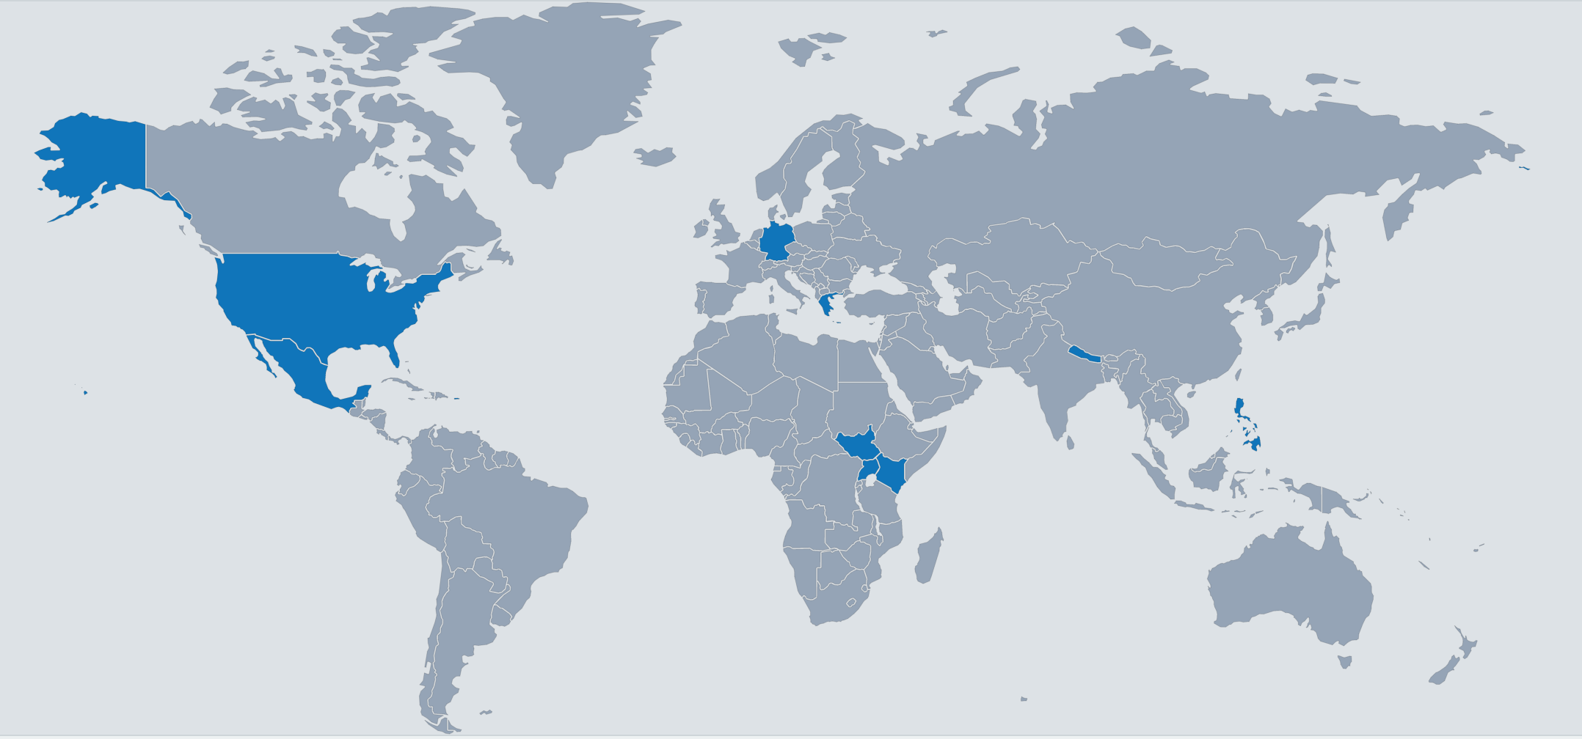
Conclusions & Questions
When a great educational tool is created, how can it reach more people with limited resources in a way which is culturally sensitive?
Notes:
She thinks there needs to be a mix of paper and technology in schools, and relying too heavily on technology makes the organization too easy for students.
Also, she still prefers paper readings, annotations, and flash cards compared to online things like Quizlet and PDF documents.

Slide 17


Interviewee #3, Joel
Junior transfer student, served in US Marines before Stanford
As a Marine, chosen to learn intensive Arabic in Monterey, CA schoolhouse
Hannes met through a friend of a friend and approached about interview
Interviewed at Coho

Slide 18

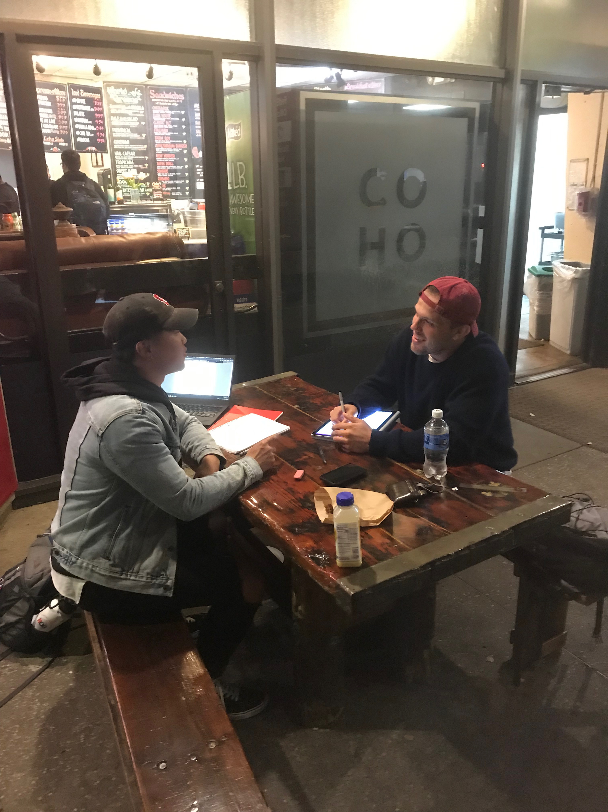
Interview Results
“64 weeks, 7 hours of class per day, 4 hours of homework per night and typically around 40% of the class will fail on their first try”
Notes:
While discussing Joel’s educational background he brought up his experience at the Defense Language Institute in Monterey, CA
In describing his time there he remarked on the intensity of the program (quote above)
His experience immediately stood out as extreme and we dug deeper into his likes and dislikes in the program and his language skills today

Slide 19
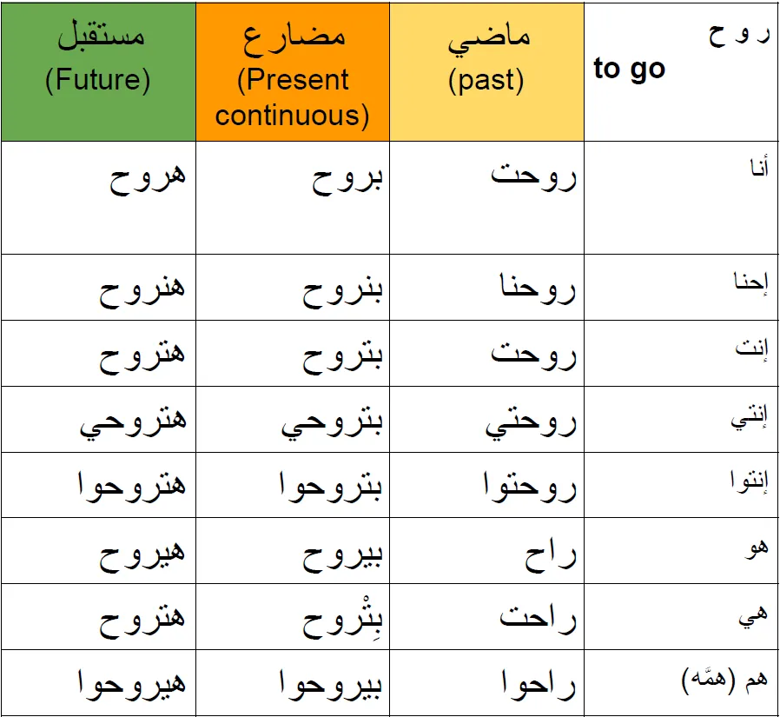

“The biggest thing that clicked was finding that moral connection with what I was learning”
Notes:
Jordanian flag: Joel provided the example to support this statement of interacting with a Jordanian Uber driver and speaking to him in his native language as a motivating factor in building his moral connection to the language and making him want to stick with it
Grammar chart: He expressed his disdain for grammar charts especially compared with actually speaking to and connecting with native speakers

Slide 20


“I typically listen to news in Arabic to keep up with my language skills… it’s also fun to hear a different perspective”
“But, I feel bad that I’m not as good as I used to be”

Slide 21
Interview Analysis
SAY “On a first date when you have nothing in common, it makes connecting much harder. Language is the same” | DO Face lit up talking about w/ Jordanian Uber driver Shook his head talking about grammar tables, intensive study
THINK Interacting with local narratives helps learning idioms, nuances, etc. Needs a way to brush up | FEEL Nostalgia, gratitude, and a sense of accomplishment, BUT ALSO frustration at difficulty of learning

Slide 22
Conclusions & Questions
Language is not a one dimensional study: cultural and dialectical nuances are often disregarded
A moral or emotional relationship with language is key to commitment and consistency

Slide 23
Overall Needs and Insights (Summary)
Technology has potential
Technology can be detrimental for interactive learning when used incorrectly
Resources still matter
Notes:
Our initial reaction was that people think too much technology does not allow for effective interactive learning, but can be useful if used correctly.
We were surprised how both teachers and students believed that technology can be detrimental to education.
Overall, we think that technology still has a potential for positive impact in the educational system, but only through a simple and universal system.

Slide 24
Notes:
This is blurry

Slide 25
Additional Interviews

Slide 26

Interviewee #4, Sam
Current Stanford Undergrad
Met in textbook section of Stanford Bookstore

Slide 27

Interview Results
*sarcastically*
“Amazing academic advisors I’ve never been to”

Slide 28

More privileged students have advantages finding internships
Extra class expenses are ridiculous

Slide 29

“Canvas can be good but teachers have to actually use it.”
“There’s a lot of variety between different classes and how easily their resources can be accessed, especially the humanities and STEM.”

Slide 30
Interview Analysis
SAY “There should be a maximum on how much I have to spend for a class.” | DO Browsing for textbooks
THINK She may think buying textbooks is an unfair financial burden | FEEL She may feel let down by Stanford

Slide 31
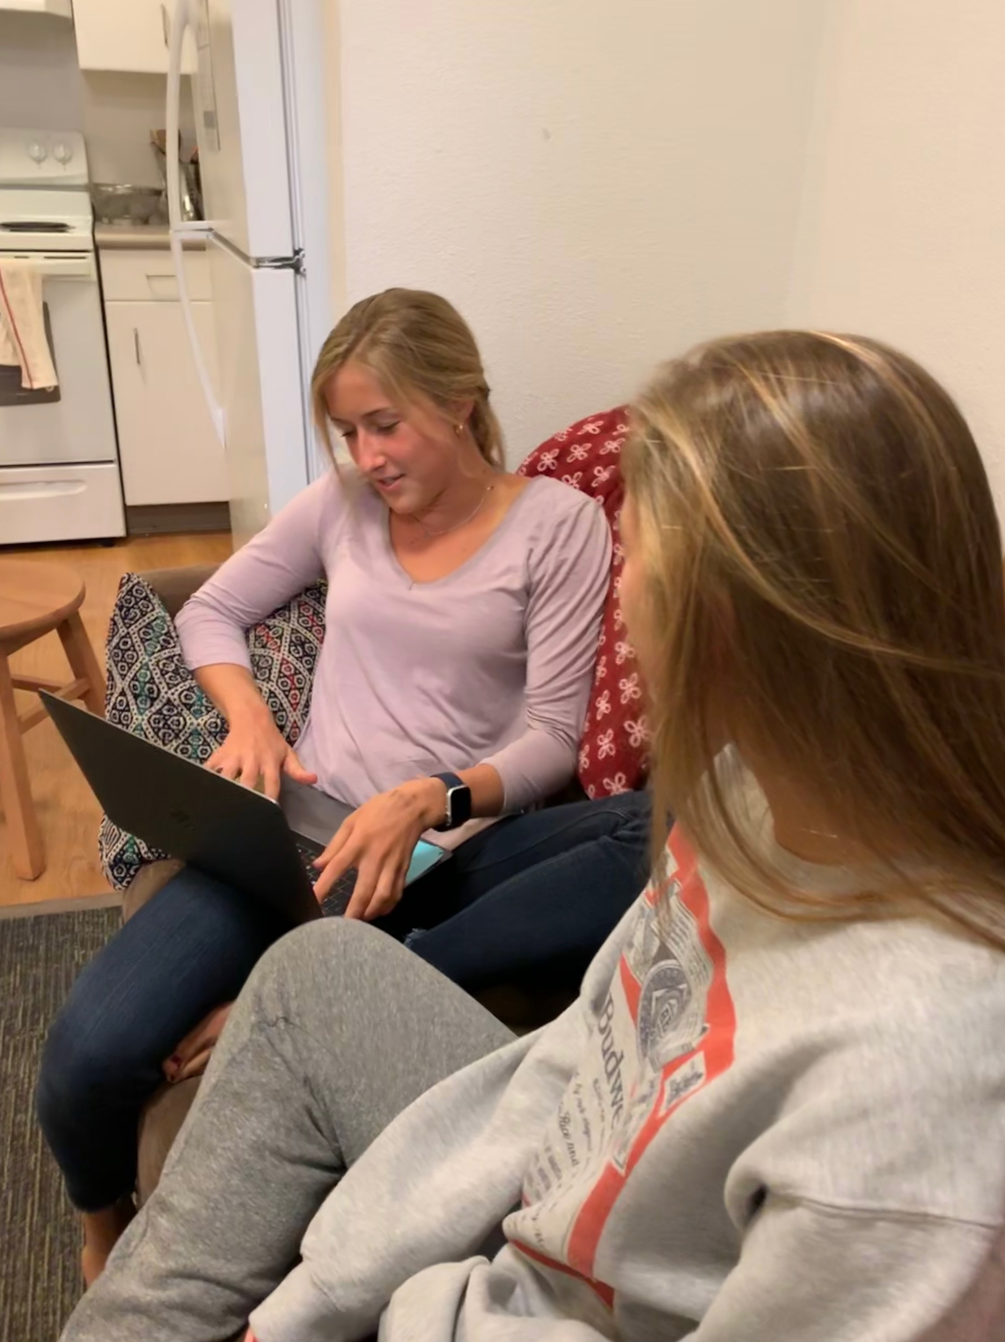
Interviewee #5, Ainsley
Junior at Menlo-Atherton High School
Has been a part of the local public school district since elementary school
Mia’s sister gave us the contact of some friends who would be willing to help out

Slide 32

Interview Results
“Transitioning from middle school and only using iPads to high school and having to use paper was a really hard adjustment”
Notes:
Everything was on Edmodo, but her iPad broke
Her grades “tanked” when her iPad broke
She couldn’t do anything without it because she had to use an internet browser and worksheets
Seemed ironic to make a bunch of 10-12 year olds be responsible for expensive technology yet have such unfortunate consequences if they didn’t have access to their tech
Notability made note taking fun and she was excited to do homework

Slide 33
Math grade improvement over a trimester due to Smartboard:
82% → 92% → 95%
Notes:
She struggled with math in elementary and middle school but once her teachers started using smartbaords in 7th grade her grades improved so much over a trimester
The way that it was taught on a smart board with “noteshells” and fill in the blank type of math problems worked so much better
Now math is one of her favorite subjects

Slide 34



Online videos have been tremendously helpful for explaining concepts in a “flipped classroom”.
Notes:
Mr. McBlair uses technology to do more of a “flipped classroom” technique
Teaches debate and AP Lang
“Explainer” in the beginning of class
Tons of youtube videos, Ted Talks, and Khan Academy tutorials to watch at home and in the beginning of class
He even makes his own videos for the class to watch
Get the “nitty gritty” out of the way so you can focus more on developing the concepts in class

Slide 35
Interview Analysis
SAY “Explainer videos” “Hard to transition” “Reliant on technology” | DO Enthusiastic about using iPads in middle school and her favorite teacher’s style of using a “flipped classroom”
THINK Reflecting on the ways in which she is grateful for tech in the classroom, but also wants to be okay without it | FEEL Excited about the ways technology has improved her education uncomfortable with her reliance on devices for schoolwork

Slide 36
Conclusions & Questions
There still needs to be a mix of paper and tech in the classroom.
They can be the most beneficial if they are combined, but detrimental if they slide too far either way.
Notes:
She thinks there needs to be a mix of paper and technology in schools, and relying too heavily on technology makes the organization too easy for students.
Also, she still prefers paper readings, annotations, and flash cards compared to online things like Quizlet and PDF documents.

Slide 37
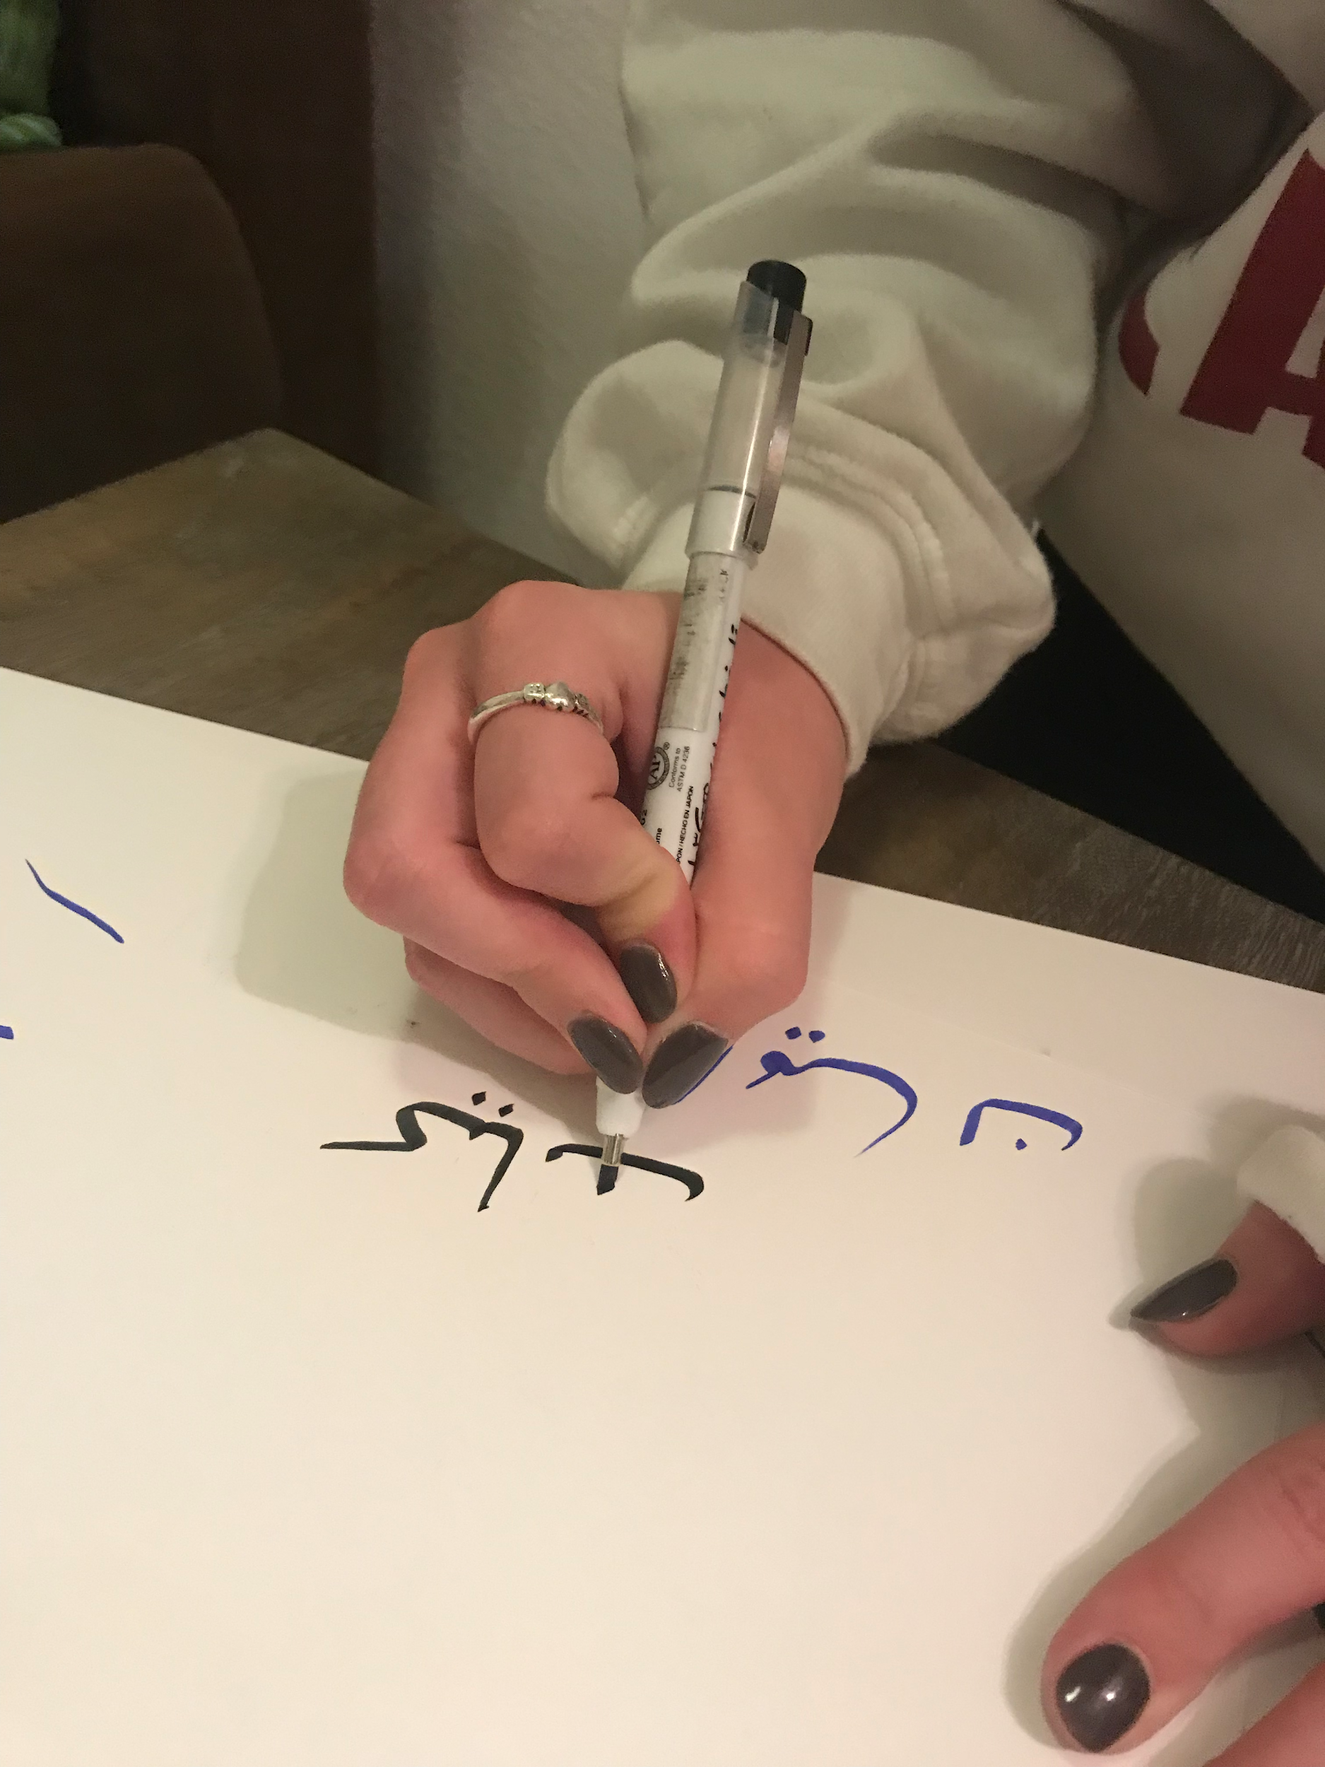
Interviewee #6, Kate
Current Stanford undergraduate
History Major
Referred to by mutual friend

Slide 38

Interview Results
English: Native
Spanish: Fluent - learned at home
French: Proficient - school
Arabic: Fluent - school and time abroad
Russian: Proficient - school, intensive programs

Slide 39
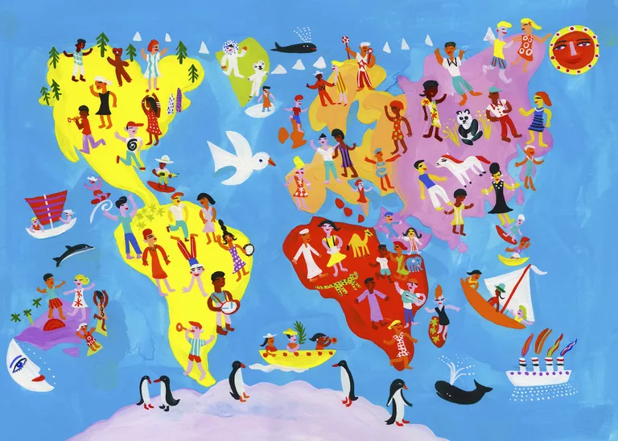
“Stanford ignores the cultural aspect of languages”
“Stanford discouraged me from studying more than one language.”

